Slide 1
Differential HPF Design
15-03-2014

Slide 2
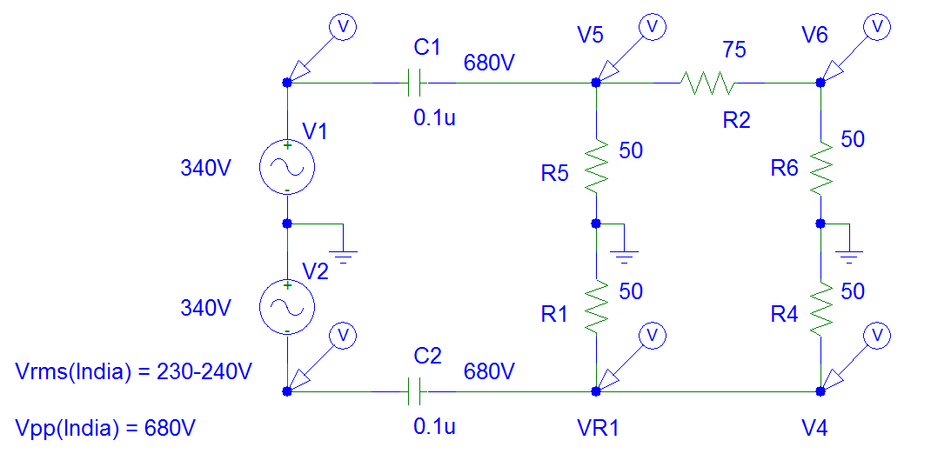
Simulated Design

Slide 3
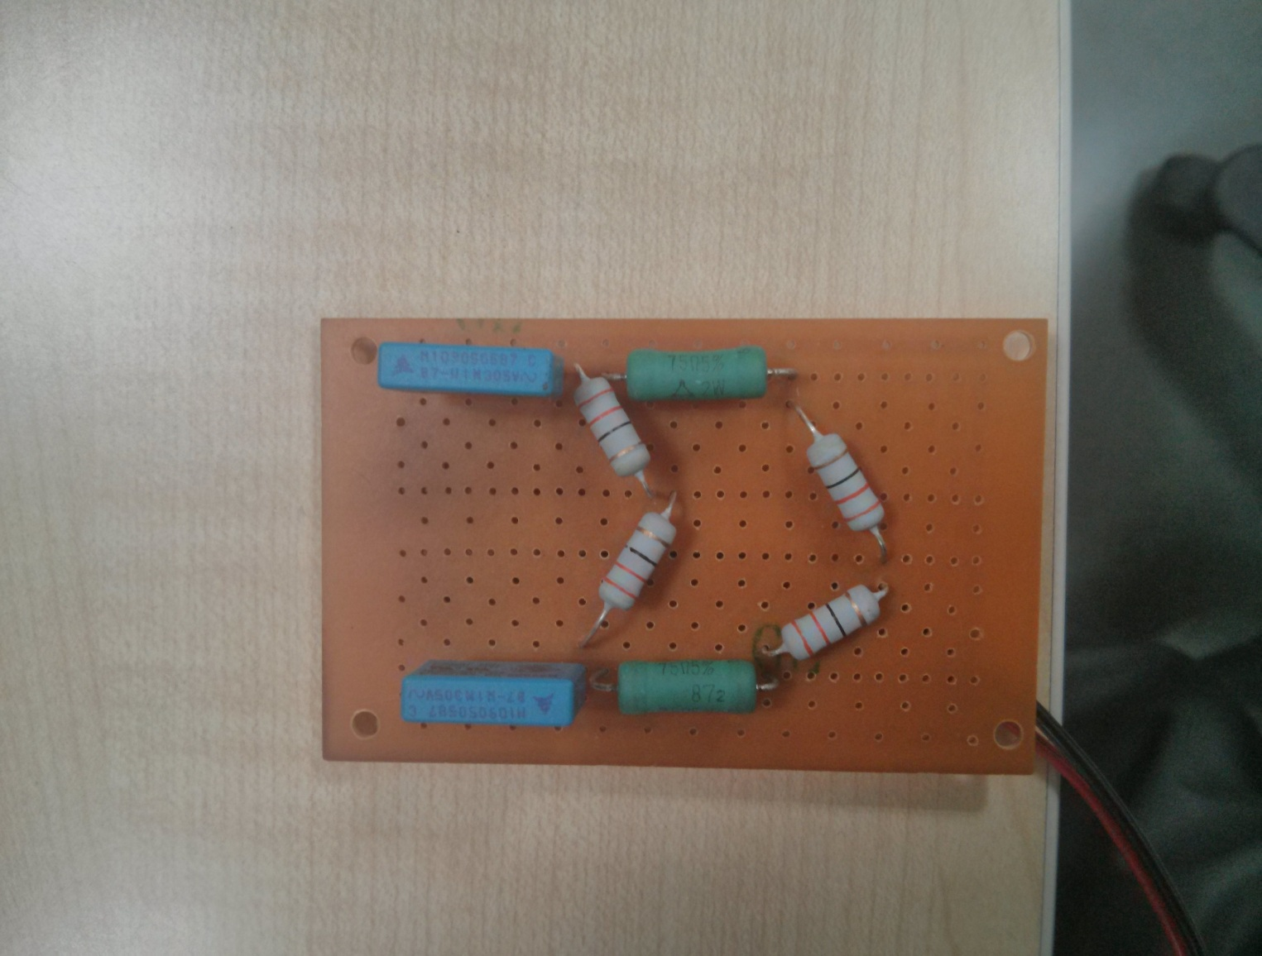
Actual Design

Slide 4
Observations
Voltage measurements
Input Node
Vrms = 240-241V
Vpp = 680V
Node Voltage (V5-VR1)
Vrms = 0.2V
Output Node Voltage
Vrms = 0.1V
Vpp = 0.2828V
Attenuation offered
Vin = 680V
Voutput = 0.2828V
Attenuation = 20log (Voutput/Vin)
= -67.620dB
Impedance = 50.1 Ohms at output node

Slide 5
Proposed Experiments-1 (18-03-14)
Test the HPF response using signal generator and spectrum analyzer. (Discuss with madam)
Test the real time HF spectrum from power line on spectrum analyzer. Try to capture traces.
Repeat same experiment 2 with a smps based device connected on the same power line.
Measure variations in spectrogram w/ and w/o smps load on power line. Store traces and do background subtraction to understand EMI signature.

Slide 6
Proposed Experiments -2 (20-03-14)
Take a known smps type and measure EMI levels w/ and w/o load.
Try to put on separate load on same smps (a dc power supply used in digital circuits can be used as SMPS and multiple RLC combinations can work as load).
Try to take real world EMI traces from electrical appliances and capture signatures and amplitude levels.
Repeat the above experiment with a particular appliance and measure EMI in different running states. Test appliance : Microwave
Test the impact of two smps based appliances on EMI compare EMI traces captured during individual vs. parallel operation to identify constructive and destructive interference.
Try to measure impact on EMI after removing the background EMI using EMI filter for mains given to appliance. (Have to order one)
Repeat the same experiment 6 with EMI filter in line with appliance to measure attenuation offered by EMI filter and validate whether it is still detectable or not.

Slide 7
Measure attenuation levels as distance from EUT increases.
Repeat same experiment with EUT being connected to different circuit branch with in a single phase power distribution system.

Slide 8
Planned Study
Study impact of impedance variation on Conducted EMI.
Measure impact of voltage fluctuation on Conducted EMI by conducting same experiment for longer duration and log real time voltage using EM6400 smart meter.
Measure real time impedances of electrical appliances using V, I and phasor information from smart meter and EMI sensor.
25-03-2014 NILM workshop poster deadline.

